Slide 1
Neurotransmitters and Their Receptors
By: Nicole Phillips

Slide 2
Learning Objectives
Differentiate classes of Neurotransmitters
Describe the location, synthesis, & inactivation of neurotransmitters discussed in class and in text
Explain the structure and function different types of receptor proteins

Slide 3
There are 2 major classes of neurotransmitter (NT)
Small molecule NT
Peptide NT
Acetylcholine
Opioids
Glutamate
Amino acids
GABA
Hypothalamic RF’s
Biogenic amines
DA, NE & Epi
Vasopressin, Oxytocin
5-HT
Purines
adenosine, ATP

Slide 4
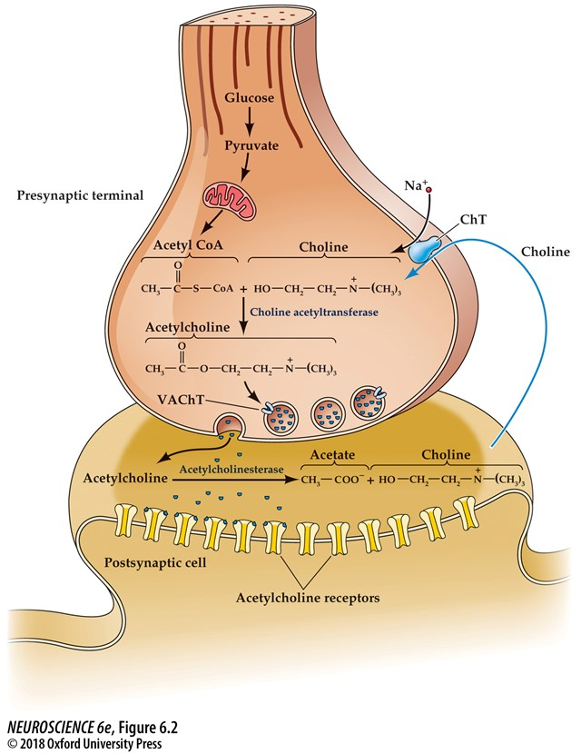
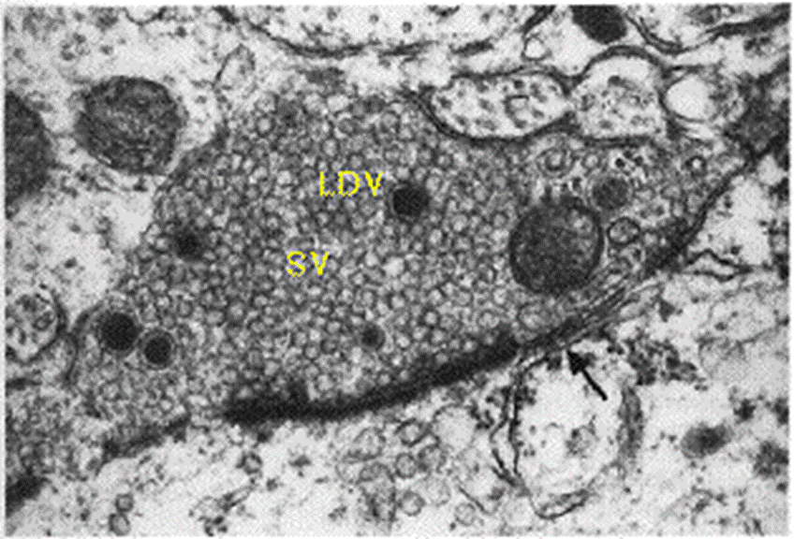
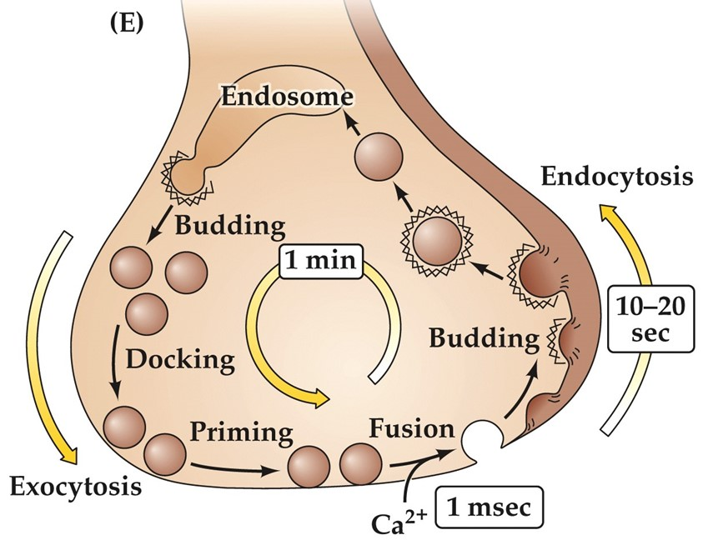
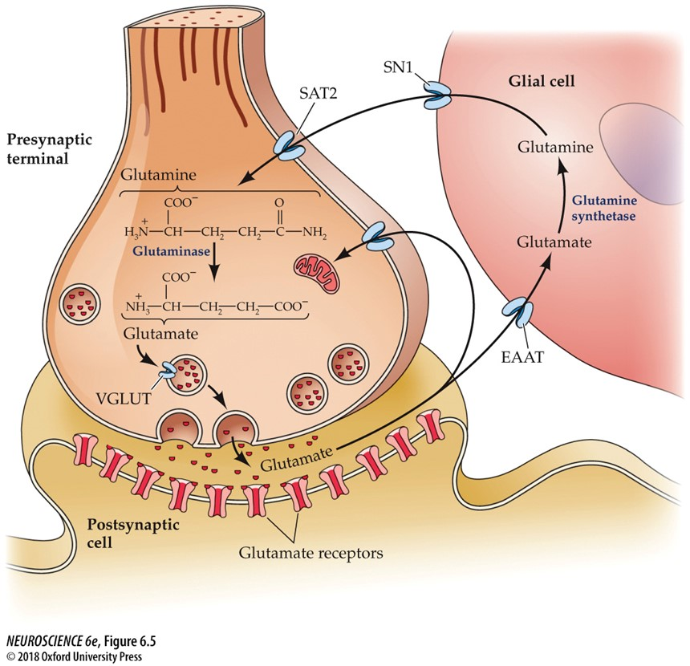
The 2 classes of NT differ in synthesis, storage, release & inactivation
Small Molecule
Peptide
enzymatic
propeptide
in final form
in soma
in nerve terminal
axonal transport to NT
Synthesis
Storage
Release
Inactivation

Slide 5
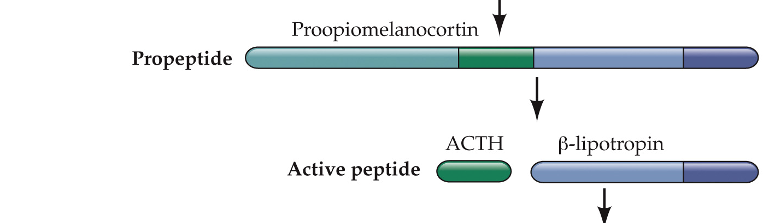
The 2 classes of NT differ in synthesis, storage, release & inactivation
Storage
Release
Inactivation
Synthesis
Small Molecule
Peptide
enzymatic
propeptide
in final form
in soma
in nerve terminal
axonal transport to NT

Slide 6
The 2 classes of NT differ in synthesis, storage, release & inactivation
Synthesis
Storage
Inactivation
Release
Small Molecule
Peptide
close to target site
target often distant
usually synaptic
frequently hormonal

Slide 7
The 2 classes of NT differ in synthesis, storage, release & inactivation
Synthesis
Storage
Release
Inactivation
Small Molecule
Peptide
reuptake
enzymatic degradation
enzymatic degradation
(peptidases)

Slide 8
The 2 classes of NT differ in synthesis, storage, release & inactivation
Small molecule
Synthesized in final form
Synthesis in NT
enzymes localized to NT
often a rate-limiting step
 | Small molecule | Peptide
Synthesis | enzymatic in final form in nerve terminal | propeptide in soma axonal transport to NT
Storage | small, clear-core vesicles vesicle recycling | large, dense-core vesicles no vesicle recycling
Release | close to target site | target often distant
Inactivation | reuptake enzymatic degradation | enzymatic degradation (peptidases)
Peptide
Synthesis of precursor
Synthesis required in soma
transcription, translation
transport to NT

Slide 9
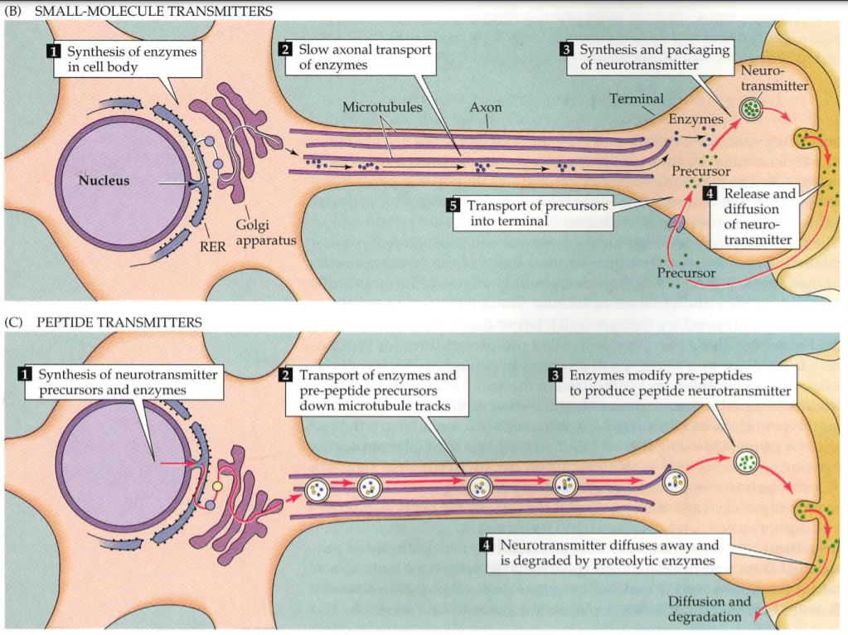
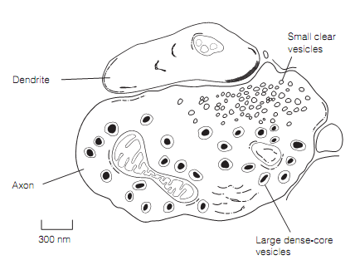

Slide 10
4 Key points for each major transmitter
Location
Synthesis
Precursors, enzymes
Inactivation
enzymatic and/or reuptake
Receptors
Ionotropic, metabotropic
Subunit composition, topology
Functional domains

Slide 11
4 Key points for each major transmitter
Transmitter | Location | Synthesis | Inactivation | Receptors
ACh | Neuromuscular junctions, Autonomic Nervous System N. basalis, tegmentum | Choline+Acetyl CoA ChAT | AChE | (i) nAChR (m) mAChR
Glutamate | >90% CNS synapses | Glutamine Glutaminase | EAATs | NMDA (NR) AMPA (GluA), KA (m) mGlu
GABA
DA
NE/Epi
5-HT
Peptides, GF’s NO/CB

Slide 12

Acetylcholine (ACh)

Slide 13
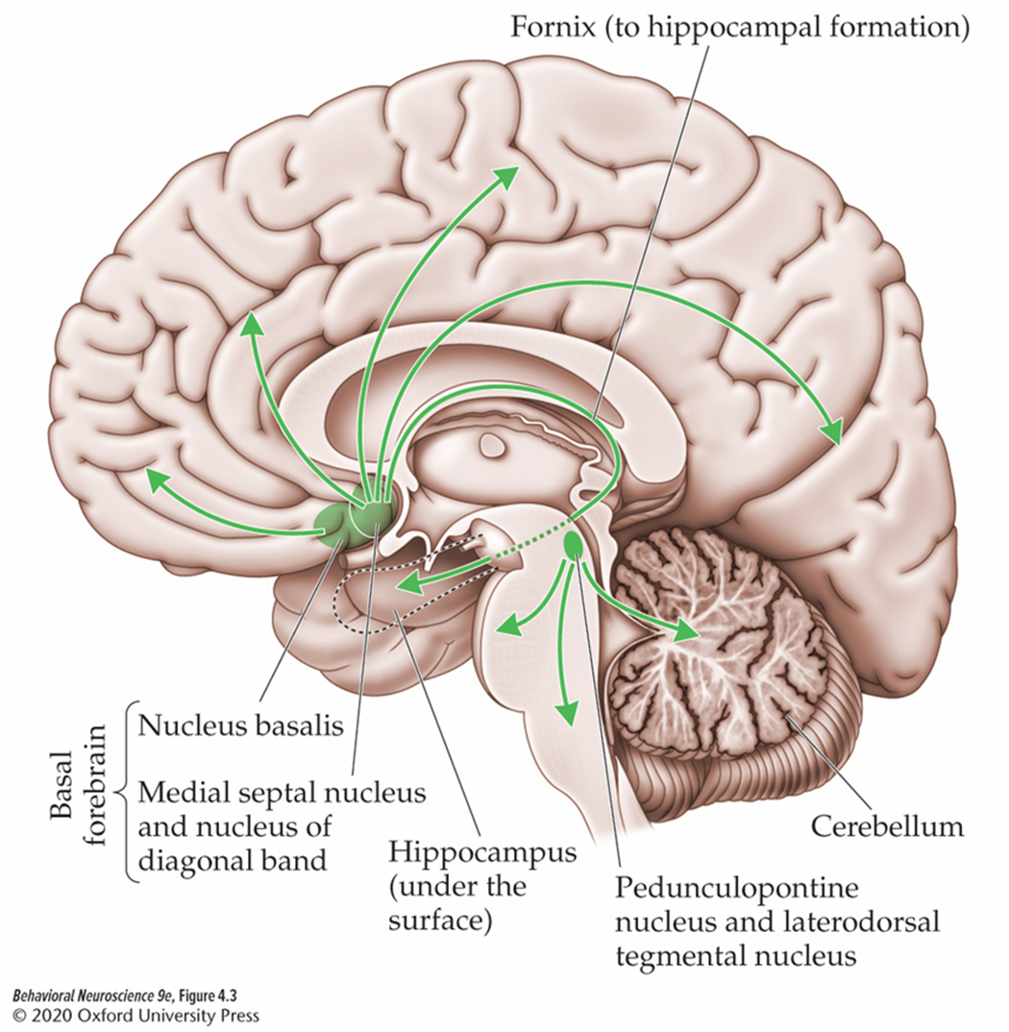
ACh Location
Peripheral NS
  Neuromuscular junction (NMJ)
  Autonomic nervous system (ANS)
Central NS
  basal forebrain

Slide 14
ACh Synthesis
Occurs in axon terminals
Precursors:
  Acetyl CoA
  Choline
ChAT combines the precursors to form ACh!
VAchT loads 10,000 ACh molecules into each vesicle!

Slide 15
ACh Inactivation
Primarily accomplished through the activity of acetylcholinesterase (AChE)
  Breaks down Ach into Acetate and Choline

Slide 16
Clinical Applications: AChE is a target of nerve agents and dementia meds
irreversible AChE inhibitors
Sarin, VX; insecticides
reversible AChE inhibitors
Aricept (donepezil); Exelon (rivastigmine)

Slide 17
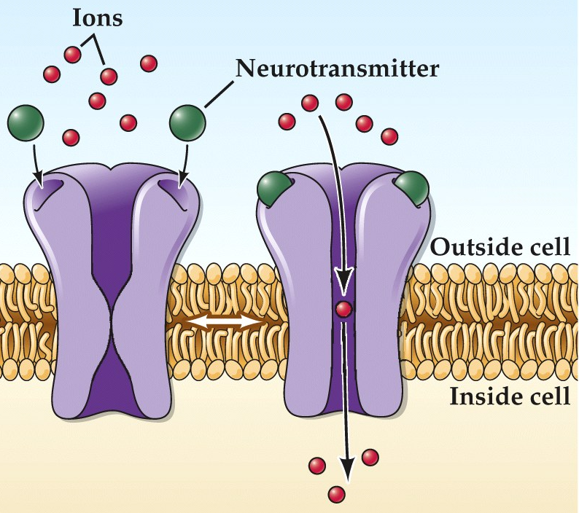
Nicotinic ACh receptors (nAChR)
  nACh receptors are ionotropic
    ACh binding opens a pore that allows both Na⁺ and K⁺ to pass through the cell membrane resulting in EPSP

Slide 18
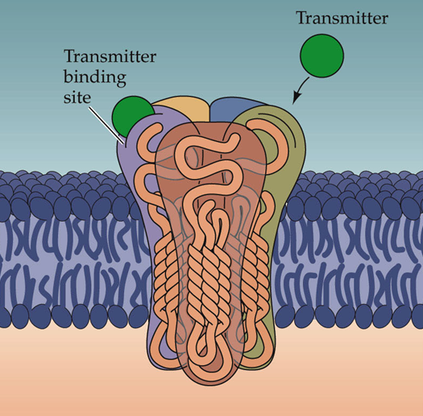
Structure and function of nACh receptors
Always 5 Subunits
  Subunits arranged around a pore
  2 or more α subunits
  NMJ: 2α:1β:1δ:1γ/ε
  ANS: 3α:2β
  2 ACh molecules bind to α subunit to open the ion channel

Slide 19
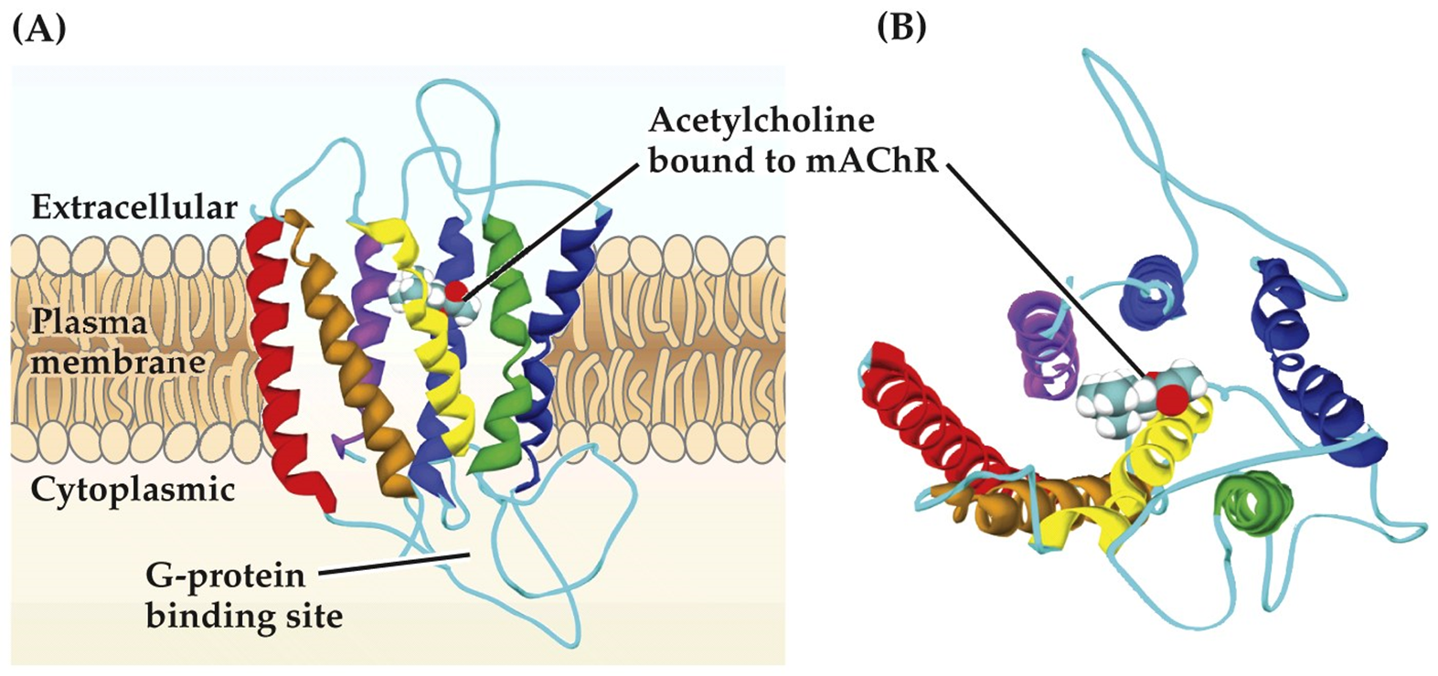
Muscarinic Ach Receptors (mAChRs)
Metabotropic
coded by 5 genes that result in 5 different receptors (M1 - M5)

Slide 20
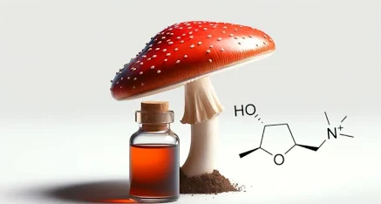
Clinical Applications:
Drugs that target mAChRs
  Agonist
    Muscarine: sympathetic activation
  Antagonists
    Atropine: pupil dilation
    Scopolomine: motion sickness
    Ipratropium: asthma
https://encrypted-tbn0.gstatic.com/images?q=tbn:ANd9GcSMwL7BJ710hfufn7QdGkBPUyMfNX70xa20ptKWx5HzpiIo1YlD2sCtxjmQgGLTOHvkKZUtvoiH3Oo9YqCm5PhNksuP_INn1QxtsOZyc5vO1w

Slide 21

Glutamate (Glu)

Slide 22

Glu Location and Synthesis
Located pretty much anywhere there are excitatory neurons
Synthesized in axon terminals
Precursor:
  Glutamine
  Metabolized into glutamate by Glutaminase
VGLUTs load glutamate into vesicles

Slide 23
Glu Inactivation
Primarily accomplished through the activity of excitatory amino acid transporters (EATTs)
  Reuptake to a glial cell or the presynaptic nerve terminal
  Once inside the cell, Glu is turned back into Glutamine by Glutamine synthetase

Slide 24
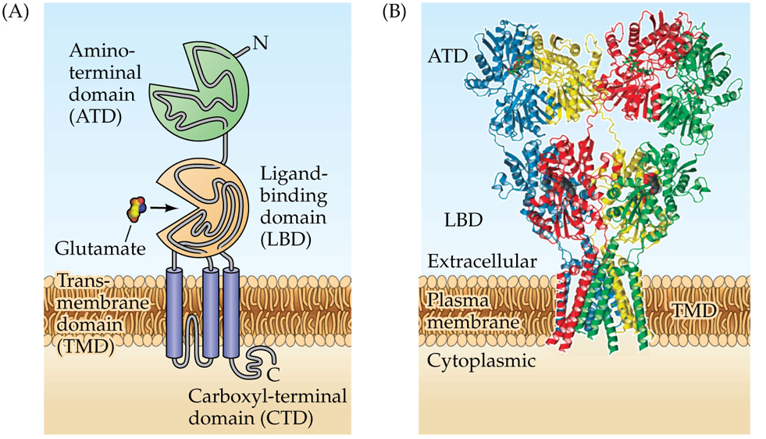
Ionotropic Glu Receptors (iGlus)
3 types:
  AMPA
  Kainate
  NMDA
Glu binding opens a pore that allows both Na⁺ and K⁺ to pass through the cell membrane resulting in EPSP
4 subunits

Slide 25
NMDA receptors are both ligand- and voltage-gated channels
Ligand-gated ion channel
Voltage-activated channel
glycine is a co-agonist
  both glu AND gly required
turns on with voltage
depolarization-dependent removal of Mg²⁺ from the pore
high permeability to Ca²⁺

Slide 26
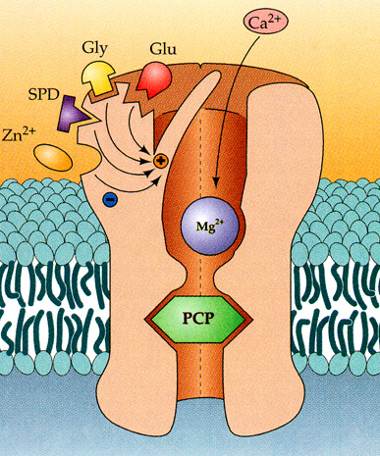
NMDA receptors are both ligand- and voltage-gated channels
depolarization-dependent removal of Mg²⁺ from the pore
high permeability to Ca²⁺

Slide 27
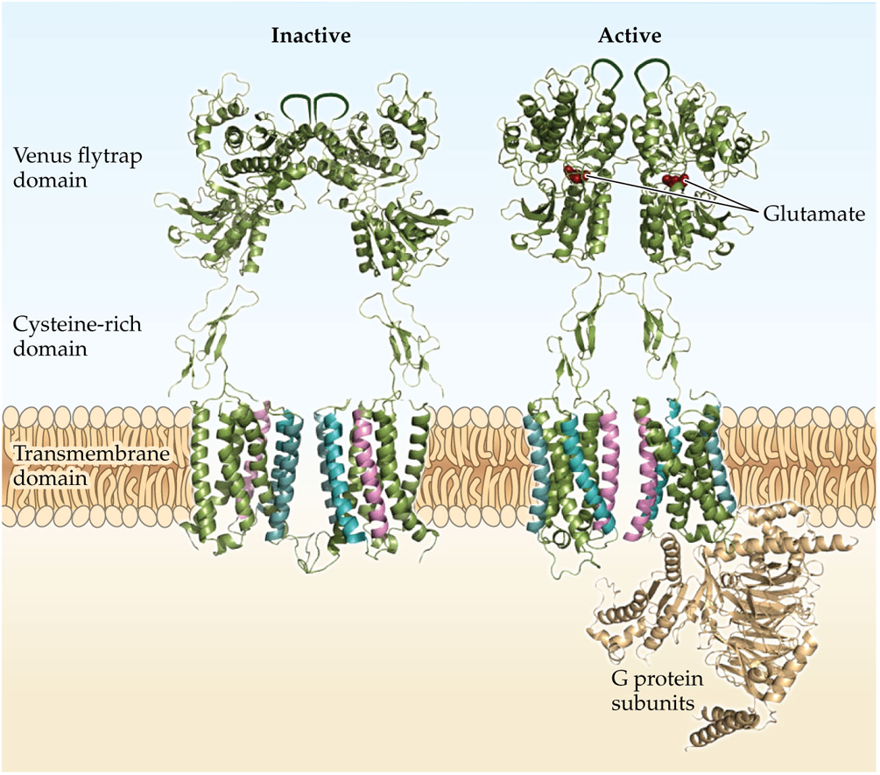
Metabotropic Glutamate Receptors (mGluRs)
Class 1: mGlu1 & 5
Class 2: mGlu2 & 3
Class 3: mGlu4 & 6-8

Slide 28
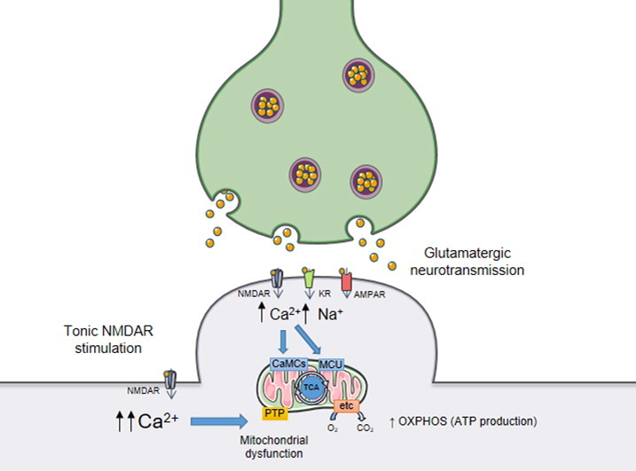
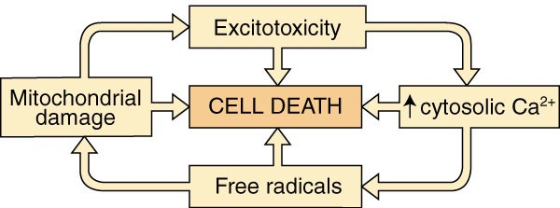
Clinical Applications: excitotoxicity
Glutamate excitotoxicity:
  pathological process by which nerve cells are damaged or killed due to excessive stimulation of glutamate receptors.
  This stimulation allows high levels of Ca2+ and Na+ to enter the cell activating enzymes that can go on to damage the cytoskeleton, membrane, and/or DNA.
May be involved in spinal cord injury, stroke, and neurodegenerative disease

